Slide 1
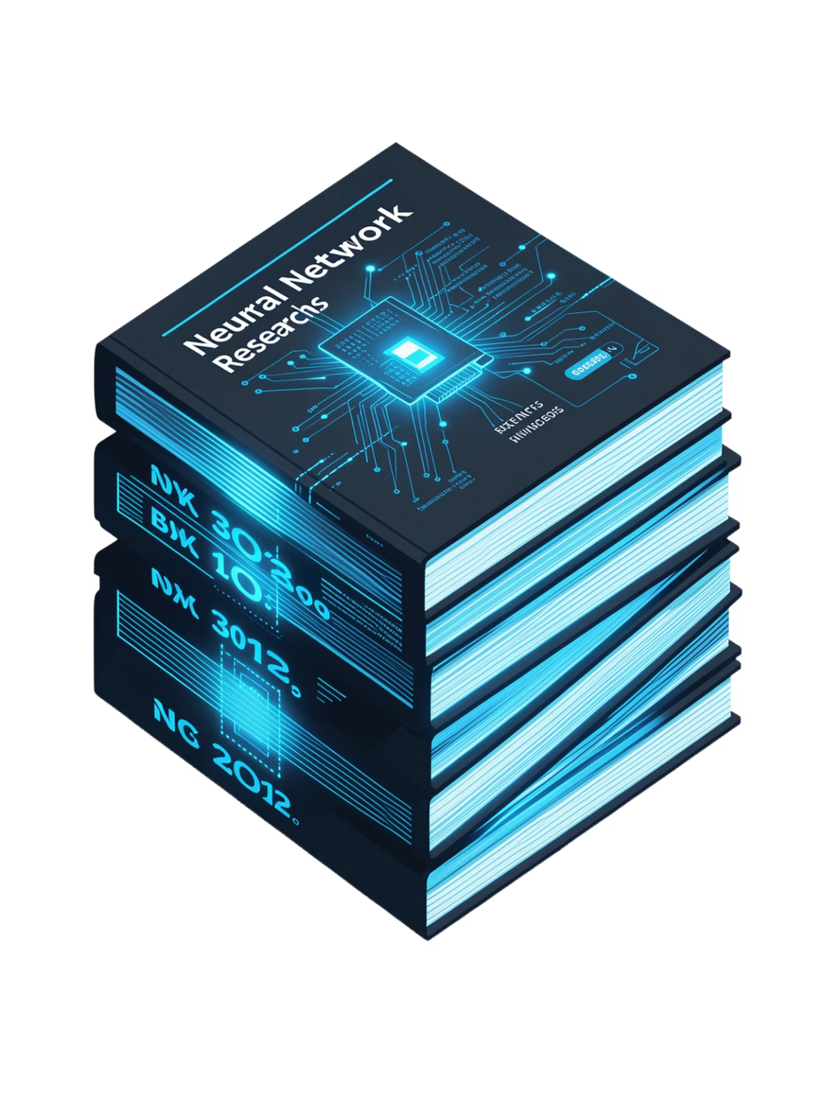

Pinnacle Plus
Research Paper Answer Bot
Grounded Question Answering over Landmark Generative AI Research Papers
Project
Focus
Generative AI Pinnacle Plus Capstone
End-to-End RAG System with Verifiable Citations
Core Pipeline
Research Papers → Hybrid Retrieval → Cross-Encoder Reranking → Google Gemini → Grounded Answer + Top-3 Evidence
Notes:
1

Slide 2

Problem Statement & Motivation
The Challenge
LLM Limitation
Project Mission
Researchers manually search lengthy PDFs (20–80 pages) to locate equations, hyperparameters, and experimental claims — a slow, error-prone process with no provenance trail.
Generic models hallucinate, lack provenance, and cannot cite exact page numbers or verify claims against original sources.
Build a production-grade RAG system that answers questions using a curated research corpus and provides verifiable paper/page-level evidence.
Success Criteria
100% grounded responses with Top-3 supporting sources — Title, Page, and Passage — for every answer.
Notes:
2

Slide 3
Curated Research Corpus: 15 Landmark Papers
Transformers & Architecture
Large Language Models
  Attention Is All You Need (2017)
  BERT (2018)
  GPT-3 (2020)
  Prompting Methods Survey (2021)
Embeddings & Retrieval
RAG Foundation
  Sentence-BERT (2019)
  Dense Passage Retrieval (2020)
  RAG (2020)
  Self-RAG (2023)
  RAG Survey (2023)
Reasoning & Agents
Advanced Topics
  Chain-of-Thought (2022)
  ReAct (2022)
  Toolformer (2023)
  Lost in the Middle (2023)
  RAGAS Evaluation (2023)
  Hallucination Survey (2023)
15
423
Landmark Papers
Total Pages
2,247
6
Semantic Chunks
Research Categories
Notes:
3

Slide 4
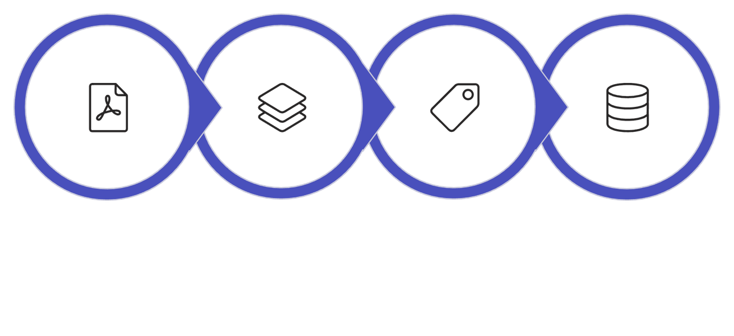
Document Ingestion & Page-Level Metadata
Why Page Metadata Matters
Exact page identification in final citations — no guessing or inference. Every chunk carries its full provenance from the moment of ingestion.
PDF Extraction
Semantic Chunking
Metadata Attachment
2,247 Indexed Chunks
Chunk Size
Overlap
Total Output
1,000 characters
150 characters (~15%)
2,247 chunks
Notes:
4

Slide 5
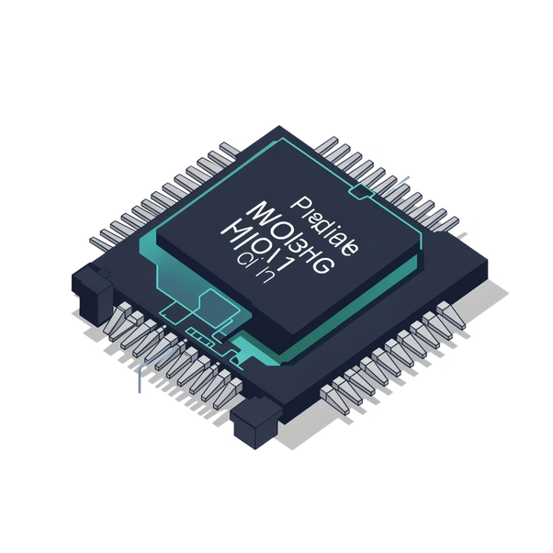

Embedding Experimentation: Open-Source vs. Commercial
Attribute | Model A — Selected | Model B — Benchmark
Model | all-MiniLM-L6-v2 | text-embedding-3-small
Dimensions | 384 | 1,536
Latency | <2ms / chunk | 80–150ms / chunk
Cost | Zero (local) | $0.02 / 1M tokens
Deployment | CPU / GPU offline | Remote API
Model A selected for ultra-fast inference, offline resilience, and full reproducibility — critical for academic deployment.
Notes:
5

Slide 6
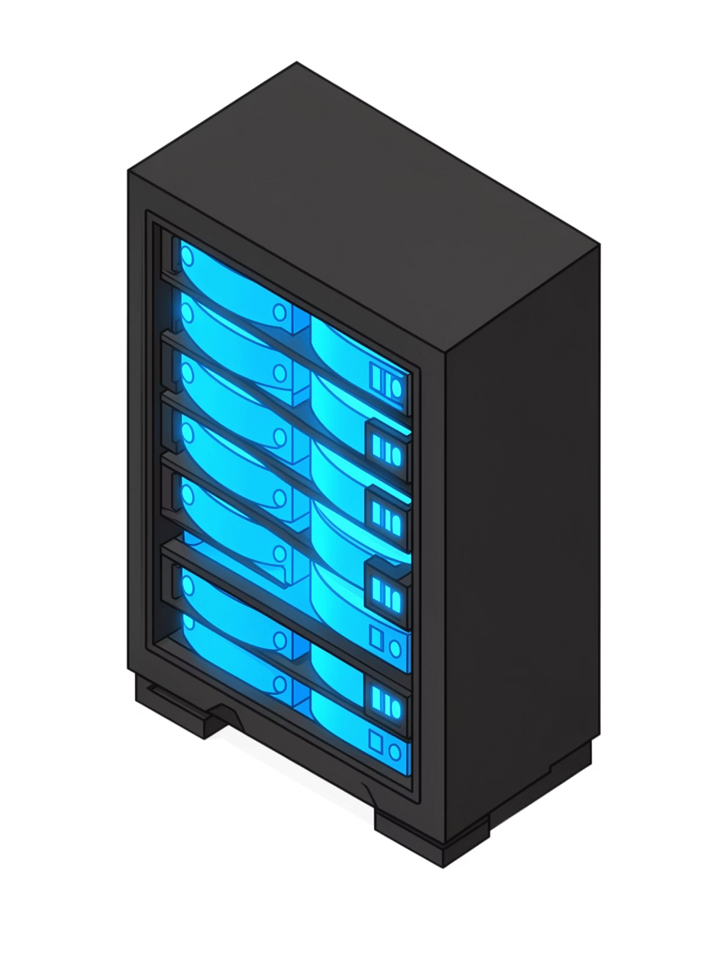




Vector Database Architecture
Engine & Backend
ChromaDB with persistent disk backend at vectorstore/chroma_db/ — instant cold-start loading without re-indexing across sessions.
Collection
papers_opensource — 2,247 indexed vectors with full metadata schema: paper_id, title, page, category, year, chunk_text.
Distance Metric
Cosine Distance: 1 − (u·v) / (‖u‖₂ ‖v‖₂) — measures angular similarity between query and chunk embeddings in 384-dimensional space.
Deterministic IDs
Format: {paper_id}_p{page}_c{chunk_idx} — guarantees reproducible retrieval and exact citation traceability across all sessions.
Notes:
6

Slide 7




Retrieval Experimentation: Four Paradigms
Dense Cosine
MMR
Pure vector similarity in 384-dimensional space. Fast and semantically rich.
Maximal Marginal Relevance — penalizes redundancy with λ=0.7 balance parameter for diverse result sets.
Hybrid Search
Two-Stage Reranking
BM25Okapi lexical + Dense semantic fused via Reciprocal Rank Fusion (k=60) for combined recall.
Hybrid top-15 → Cross-Encoder (ms-marco-MiniLM-L-6-v2) → Top-3 final chunks with surgical precision.
Notes:
7

Slide 8
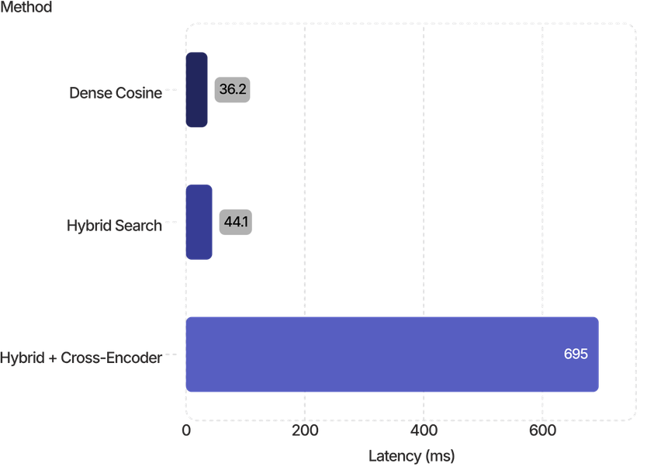

Retrieval Benchmark Results
Evaluated across 10 canonical gold-standard research queries. All three leading strategies achieve Hit@3 = 100% and MRR = 0.95.
Method | Hit@1 | Hit@3 | MRR
Dense Cosine | 90% | 100% | 0.95
Hybrid Search | 90% | 100% | 0.95
Hybrid + Cross-Encoder ✓ | 90% | 100% | 0.95
Production Selection: Hybrid + Cross-Encoder balances recall robustness with surgical precision reranking. The added latency (~694ms) is acceptable for research Q&A workloads.
Notes:
8

Slide 9
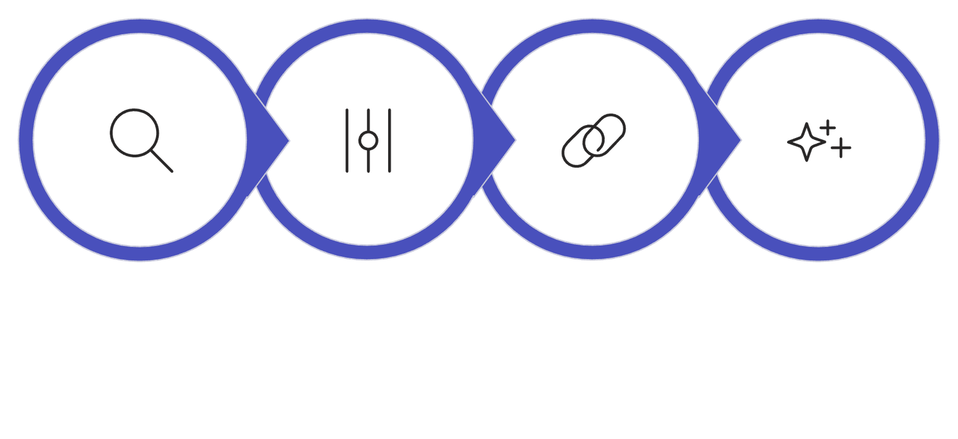
End-to-End RAG Architecture
Recall
Precision
Grounding
Generation
Stage 1 — Recall
Stage 2 — Precision
Hybrid Retrieval via RRF → Top-15 candidates in ~44ms
Cross-Encoder reranking → Top-3 highest-relevance passages
Stage 3 — Grounding
Stage 4 — Generation
Context formatter injects Title + Page into prompt
Google Gemini gemini-2.5-flash synthesizes grounded answer
Notes:
9

Slide 10


Grounding & Anti-Hallucination Strategy
1
Retrieval Grounding
Strict system prompt enforced: "Base answers ONLY on provided context. Do not invent information." The model is constrained to retrieved passages exclusively.
2
Relevance Check
Heuristic sufficiency floor evaluates whether retrieved context adequately addresses the query before generation proceeds.
3
Fallback Mechanism
Out-of-domain or ungrounded queries trigger safe refusal: "The provided research papers do not contain sufficient information."
4
Citation Structure
Every answer includes Paper Title, Exact 1-Indexed Page, and Verbatim Supporting Passage — fully verifiable by any reader.
Outcome: Reduces unsupported generation through multi-layer retrieval grounding and deterministic fallback — every answer is traceable to its source.
Notes:
10

Slide 11





RAG Evaluation Results
Validated on 10 canonical queries across 15 landmark papers. Results cover retrieval, grounding, citation accuracy, and refusal behavior.
100%
100%
Retrieval
Groundedness
True papers appeared in the Top-3 every time.
All answers were supported by source material.
100%
100%
Citation Accuracy
Anti-Hallucination
Citations matched titles and page numbers exactly.
Unsupported prompts were correctly refused.
Evaluation Pipeline
Question, retrieval, answer, citation check, and failure analysis.
Query
Retrieval Eval
Grounded Answer
Selected 10 research questions.
Checked Top-3 relevance against known sources.
Scored responses for evidence alignment.
Citation Verify
Failure Analysis
Verified titles, pages, and source details.
Reviewed misses and refusals for tuning.
All four metrics scored 100%.

Slide 12

Streamlit Application
Production-ready research UI on top of the RAG pipeline for evaluation, exploration, and grounded answering.
System Architecture
Interface Features
01
Knowledge Base Stats
Paper Catalog Browser
User Input
15 papers, 423 pages, and 2,247 chunks are indexed.
Browse the source library with arXiv links.
Choose a sample or ask a question.
02
Streamlit Layer
Sample Query Dropdown
Custom Question Input
Handles state, routing, and rendering.
Ten preset research questions support quick testing.
Ask free-form questions for deeper research.
03
RAG Pipeline
Grounded Answer Display
Visual Citation Cards
Retrieves and reranks the strongest source passages.
Shows answers with latency and model info.
Shows ranked sources, page references, and quotes.
04
Google Gemini
Generates grounded answers from the evidence.
05
Answer + Evidence
Shows the response beside cited evidence cards.

Slide 13

Technical Challenges & Limitations
Eight key constraints across ingestion, retrieval, generation, and infrastructure.
PDF Text Extraction
Page-Level Metadata
Chunk-Size Selection
Table & Figure Extraction
OCR can be noisy on scanned or low-quality PDFs.
Page references must survive chunking for traceable citations.
1,000 characters balances context and precision.
Tables and figures are only partially preserved.
Retrieval Quality
Reranking Latency
Context Granularity
API Dependency
Hybrid retrieval reaches 90% Hit@1, but misses still happen.
The reranker adds about ~650ms per query.
Top chunks can mix evidence from different papers.
Gemini depends on internet access and external availability.
90% Hit@1
~650ms
Current retrieval ceiling
Reranking overhead
1,000 chars
Text-Only
Chosen chunk size
Tables and figures are limited

Slide 14

Conclusion & Key Learnings
From paper retrieval to grounded answers. Pinnacle Plus shows that a well-built RAG pipeline can deliver grounded, verifiable answers on a curated academic corpus.
It preserves structure, citations, and evidence from ingestion through generation.
System Achievements
1
Curated Corpus
2
Page-Preserving Ingestion
15 papers spanning 2017–2023.
1-indexed page metadata stays intact after chunking.
3
Dual Embeddings
4
Two-Stage Retrieval
Open-source 384d embeddings gave the best balance of speed and simplicity.
Dense + BM25 retrieval feeds cross-encoder reranking.
Performance Summary
The final system reached the top line on all three evaluation measures.
100%
100%
100%
Retrieval Relevance
Groundedness
Citation Accuracy
Thank you — Questions & Discussion: The Streamlit app delivers evidence-grounded answers with source traceability.

